Slide 1


GenLite Azure Technical Architecture

Slide 2
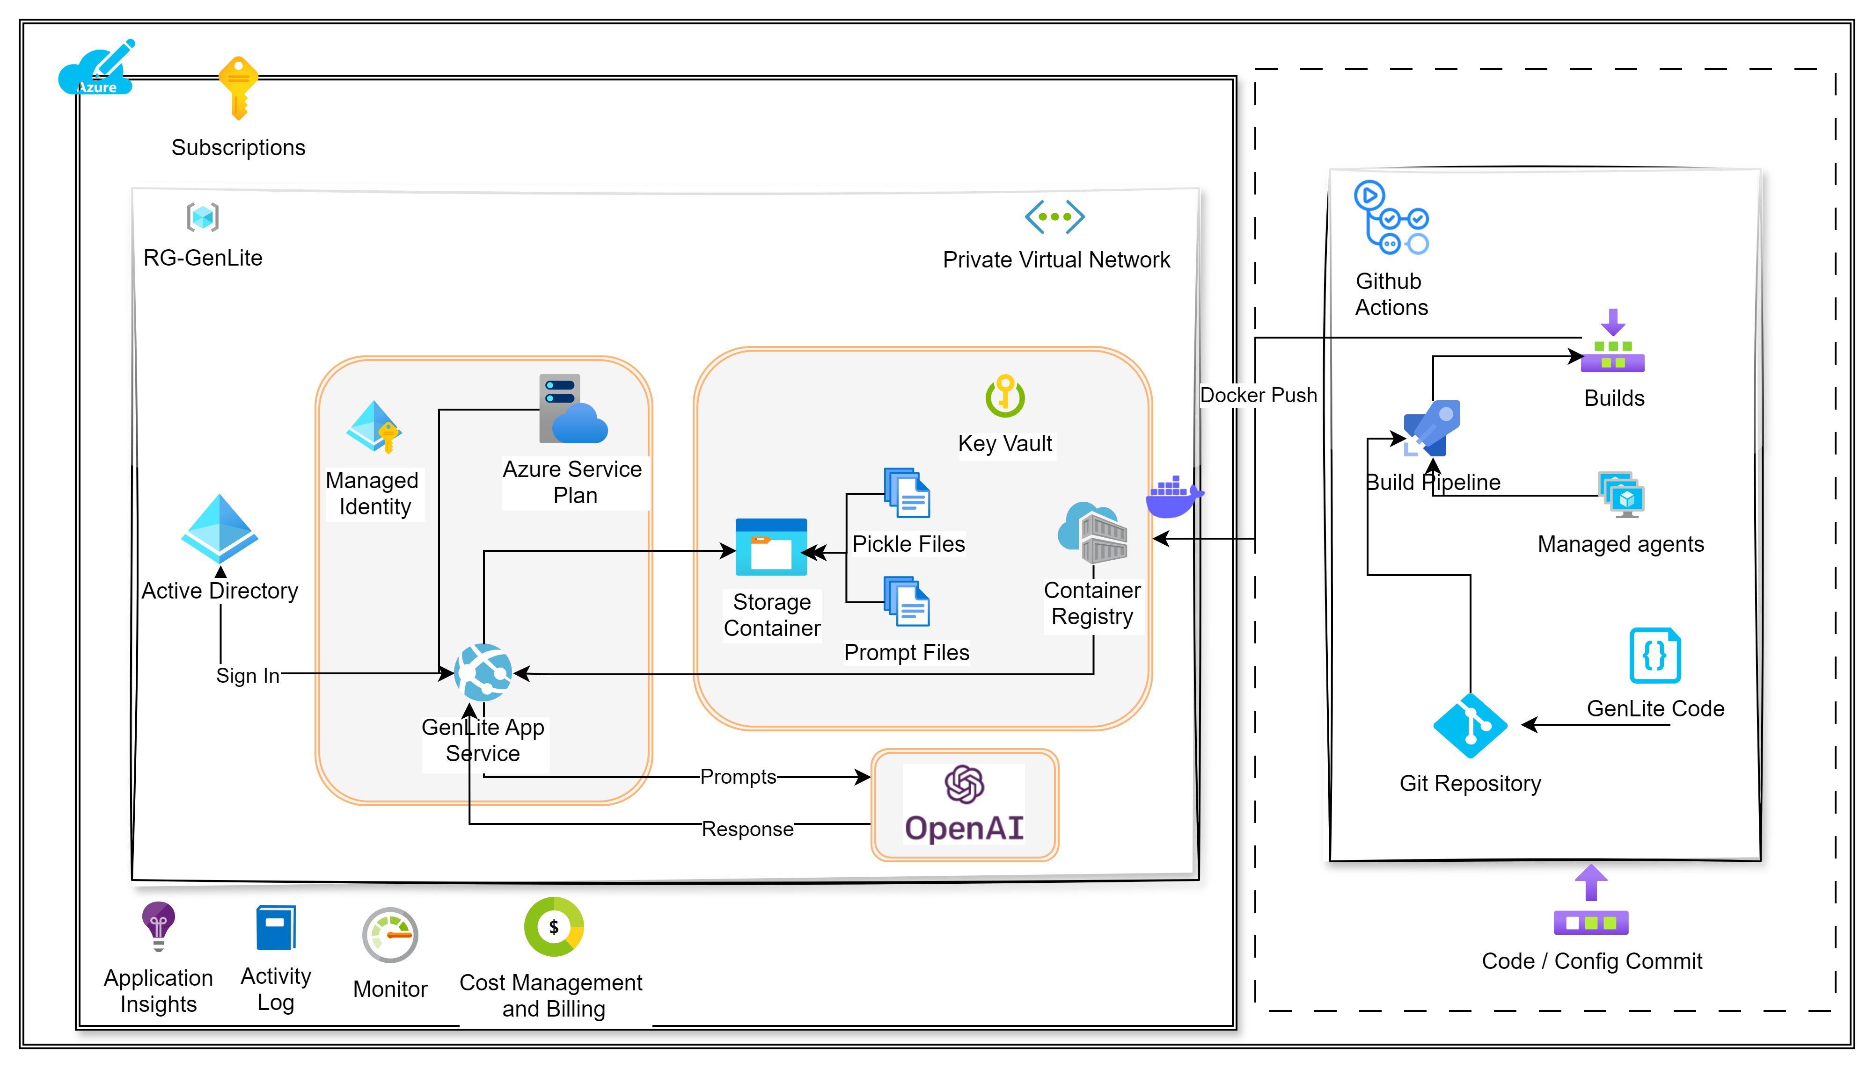
Technical Architecture – Azure with CI/CD pipeline

Slide 3
Infrastructure & Software Requirements
# | Services | Configuration | Comments
1 | Resource Group | rg-genlite | Service principle – Client id/ Secret / tenant ID
2 | Virtual Network | Virtual Network Subnets App subnet ACR subnet | Leverage existing one or create dedicated subnet for Genlite with access enabled to App Service, CICD pipeline infra and Azure blob storage
3 | App Service plans | Operating System - Linux Size - P2v3 Instance - 2
4 | App Services | Operating System - Linux Publish - Docker Container | Restricted with Virtual Network (Private)
5 | Container Registry | Pricing plan - Premium Connectivity configuration - Private access
6 | Key vaults | Sku (Pricing tier) - Standard | Associated within Vnet and Managed Identity
7 | Storage Account |  | Storage account store Pickle files, Prompt files, as well as input and output folders to store source code for conversion. Estimated 100GB max
8 | Open AI | Pricing Tier - Standard Models - gpt-35-turbo-16k and text-embedding-ada-002 | Model - gpt-35-turbo-16k Version - 0613 Capacity - 120K TPM Rate Limit - 120000
9 | Github Actions | Orchestration | Check with Sudhir for Github Actions

Slide 4
Gentile Usage Steps
Load the source code in Input folder in Azure Blob Storage
Use GenLite to convert the code to Output folder
Review and do manual adjustments as needed
Test the code
Commit the validated code into new GitHub repo

Slide 5
Preparation – What to ask Infra team
Action Items:
Resource group with Service Principle will be provided by Nitin R – ETC: Sep 03rd 2024
Github Repo / Actions will be provisioned by different group –Sudhir to provide direction
Admin permissions needed to setup repo and configure Github Actions
GenLite team will provision resources and deploy Genlite – dependent on above ( Aravid Moturi)
Provisions the Infrastructure via ARM templates
Pushes the code to Github Repo
Creates Pipelines
Deploys the code to App Service

